Slide 2
Lesson 1: Circumference
Reinforcement…
Reasonable Approximations

Slide 3
How this works…
Make a sign to hold up for ‘greater than’ and a sign for ‘less than’.
Hold up your symbol (showing > or < ) to show if the particular property – circumference, diameter or radius – is greater than or less than the stated value
Don’t take too long making each decision; you are allowed to change your mind as you get more information with each slide!
Think about:
What is a reasonable estimate?
When does having more information help?

Slide 4
is one revolution OF…
the large wheel of a
Penny farthing bicycle
more than, or less than,
5 metres?

Slide 5
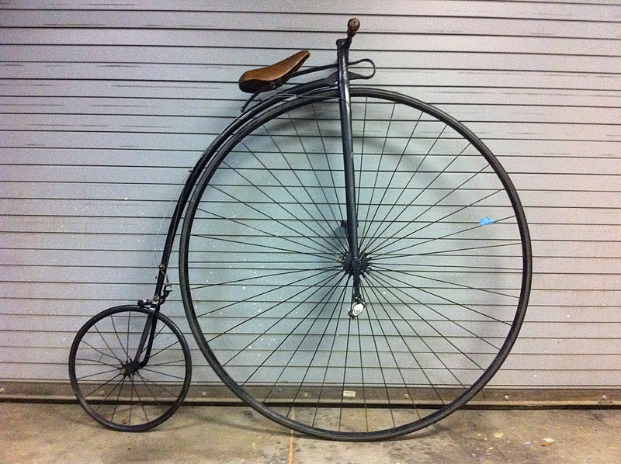
is one revolution OF…
the large wheel of a
Penny farthing bicycle
more than, or less than,
5 metres?
Image taken from https://commons.wikimedia.org/wiki/File:Ariel_50_inch_High_Wheel_Bike.jpg?uselang=en-gb

Slide 6
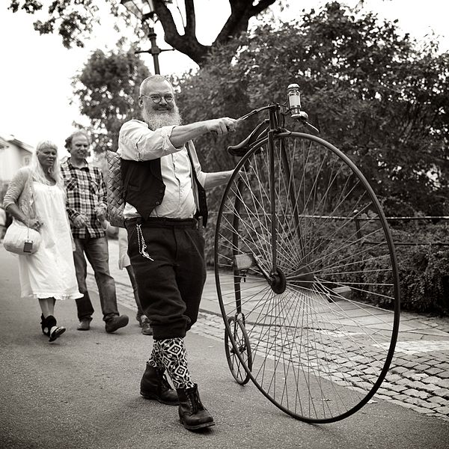
is one revolution OF…
the large wheel of a
Penny farthing bicycle
more than, or less than,
5 metres?
Image taken from https://commons.wikimedia.org/wiki/File:High_wheeler.jpg?uselang=en-gb
<

Slide 7
is one revolution Of…
the wheel of a mine
dump truck more than,
or less than, 10 metres?

Slide 8
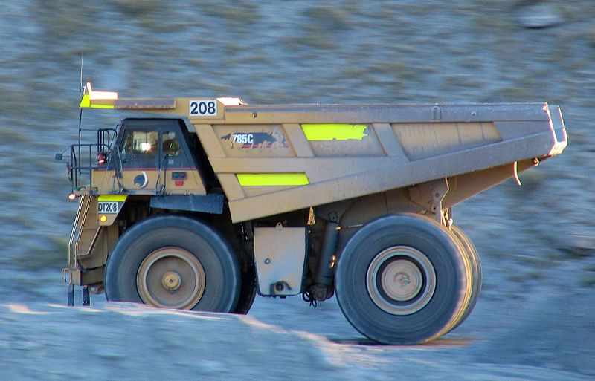
is one revolution Of…
the wheel of a mine
dump truck more than,
or less than, 10 metres?
Image taken from https://commons.wikimedia.org/wiki/File:OceanaGold_mining_truck_Macraes,_NZ.jpg?uselang=en-gb

Slide 9
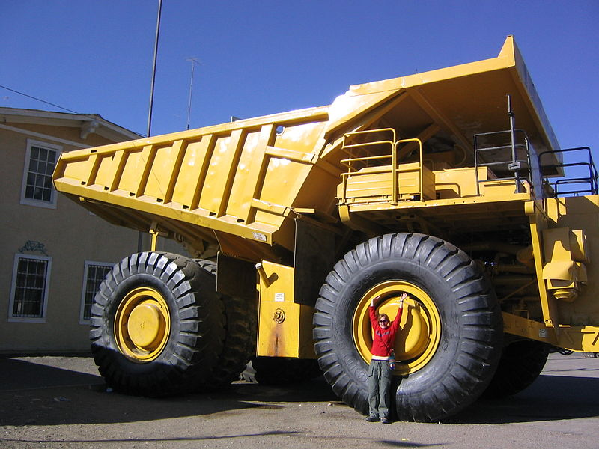
is one revolution Of…
the wheel of a mine
dump truck more than,
or less than, 10 metres?
Image taken from https://commons.wikimedia.org/wiki/File:Big_South_American_dump_truck.jpg?uselang=en-gb
<

Slide 10
Is one revolution of…
the London Eye
more than, or less than
500 m?

Slide 11
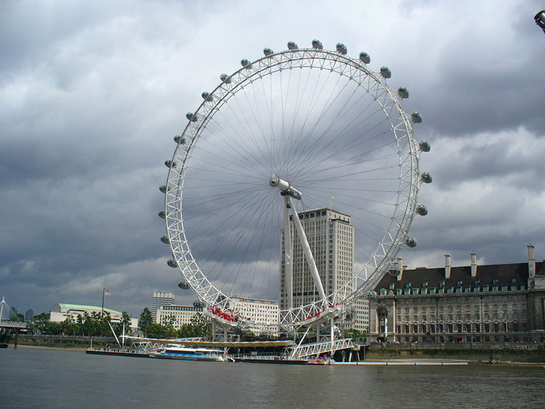
Is one revolution of…
the London Eye
more than, or less than
500 m?
By hobbesnblue, CC BY-SA 3.0, https://commons.wikimedia.org/w/index.php?curid=47383540

Slide 12

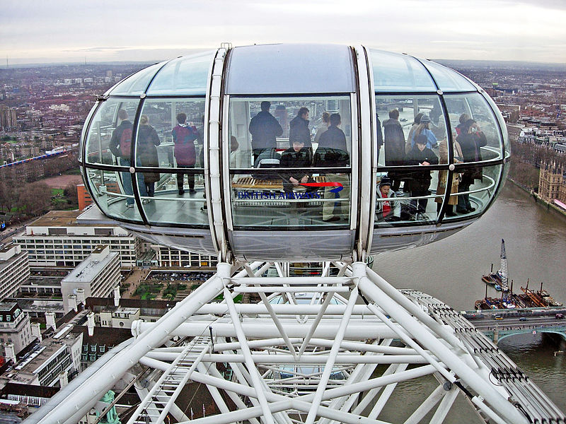
Is one revolution of…
By hobbesnblue, CC BY-SA 3.0, https://commons.wikimedia.org/w/index.php?curid=47383540
the London Eye
more than, or less than
500 m?
<
Image taken from https://commons.wikimedia.org/wiki/File:London_Eye_Pod.jpg?uselang=en-gb

Slide 13
Does the…
tip of the minute hand
of a “standard” wall clock
travel more than, or less than
1metre in one hour?

Slide 14
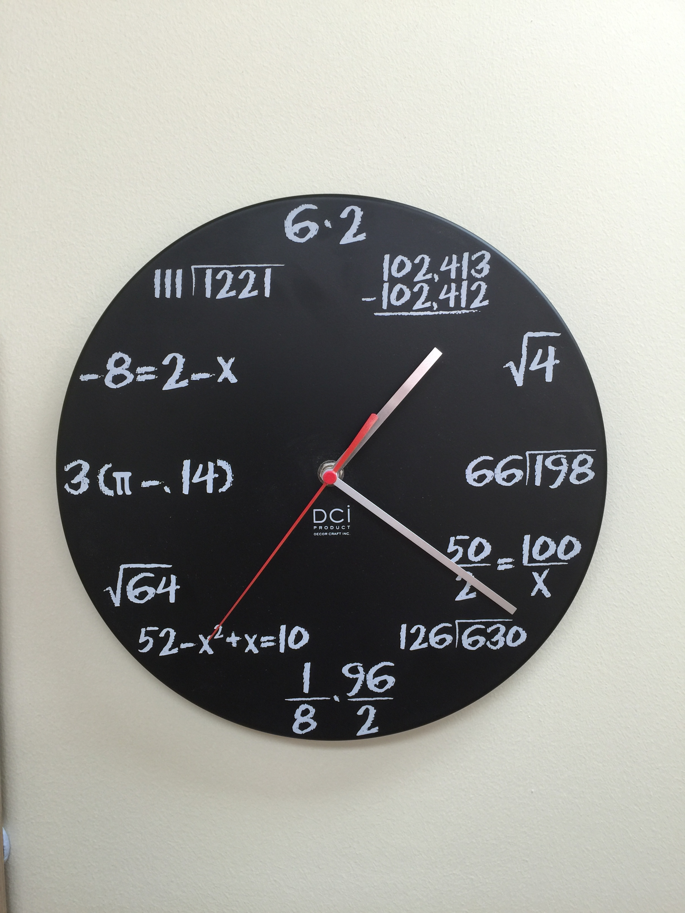
Does the…
tip of the minute hand
of a “standard” wall clock
travel more than, or less than
1metre in one hour?

Slide 15
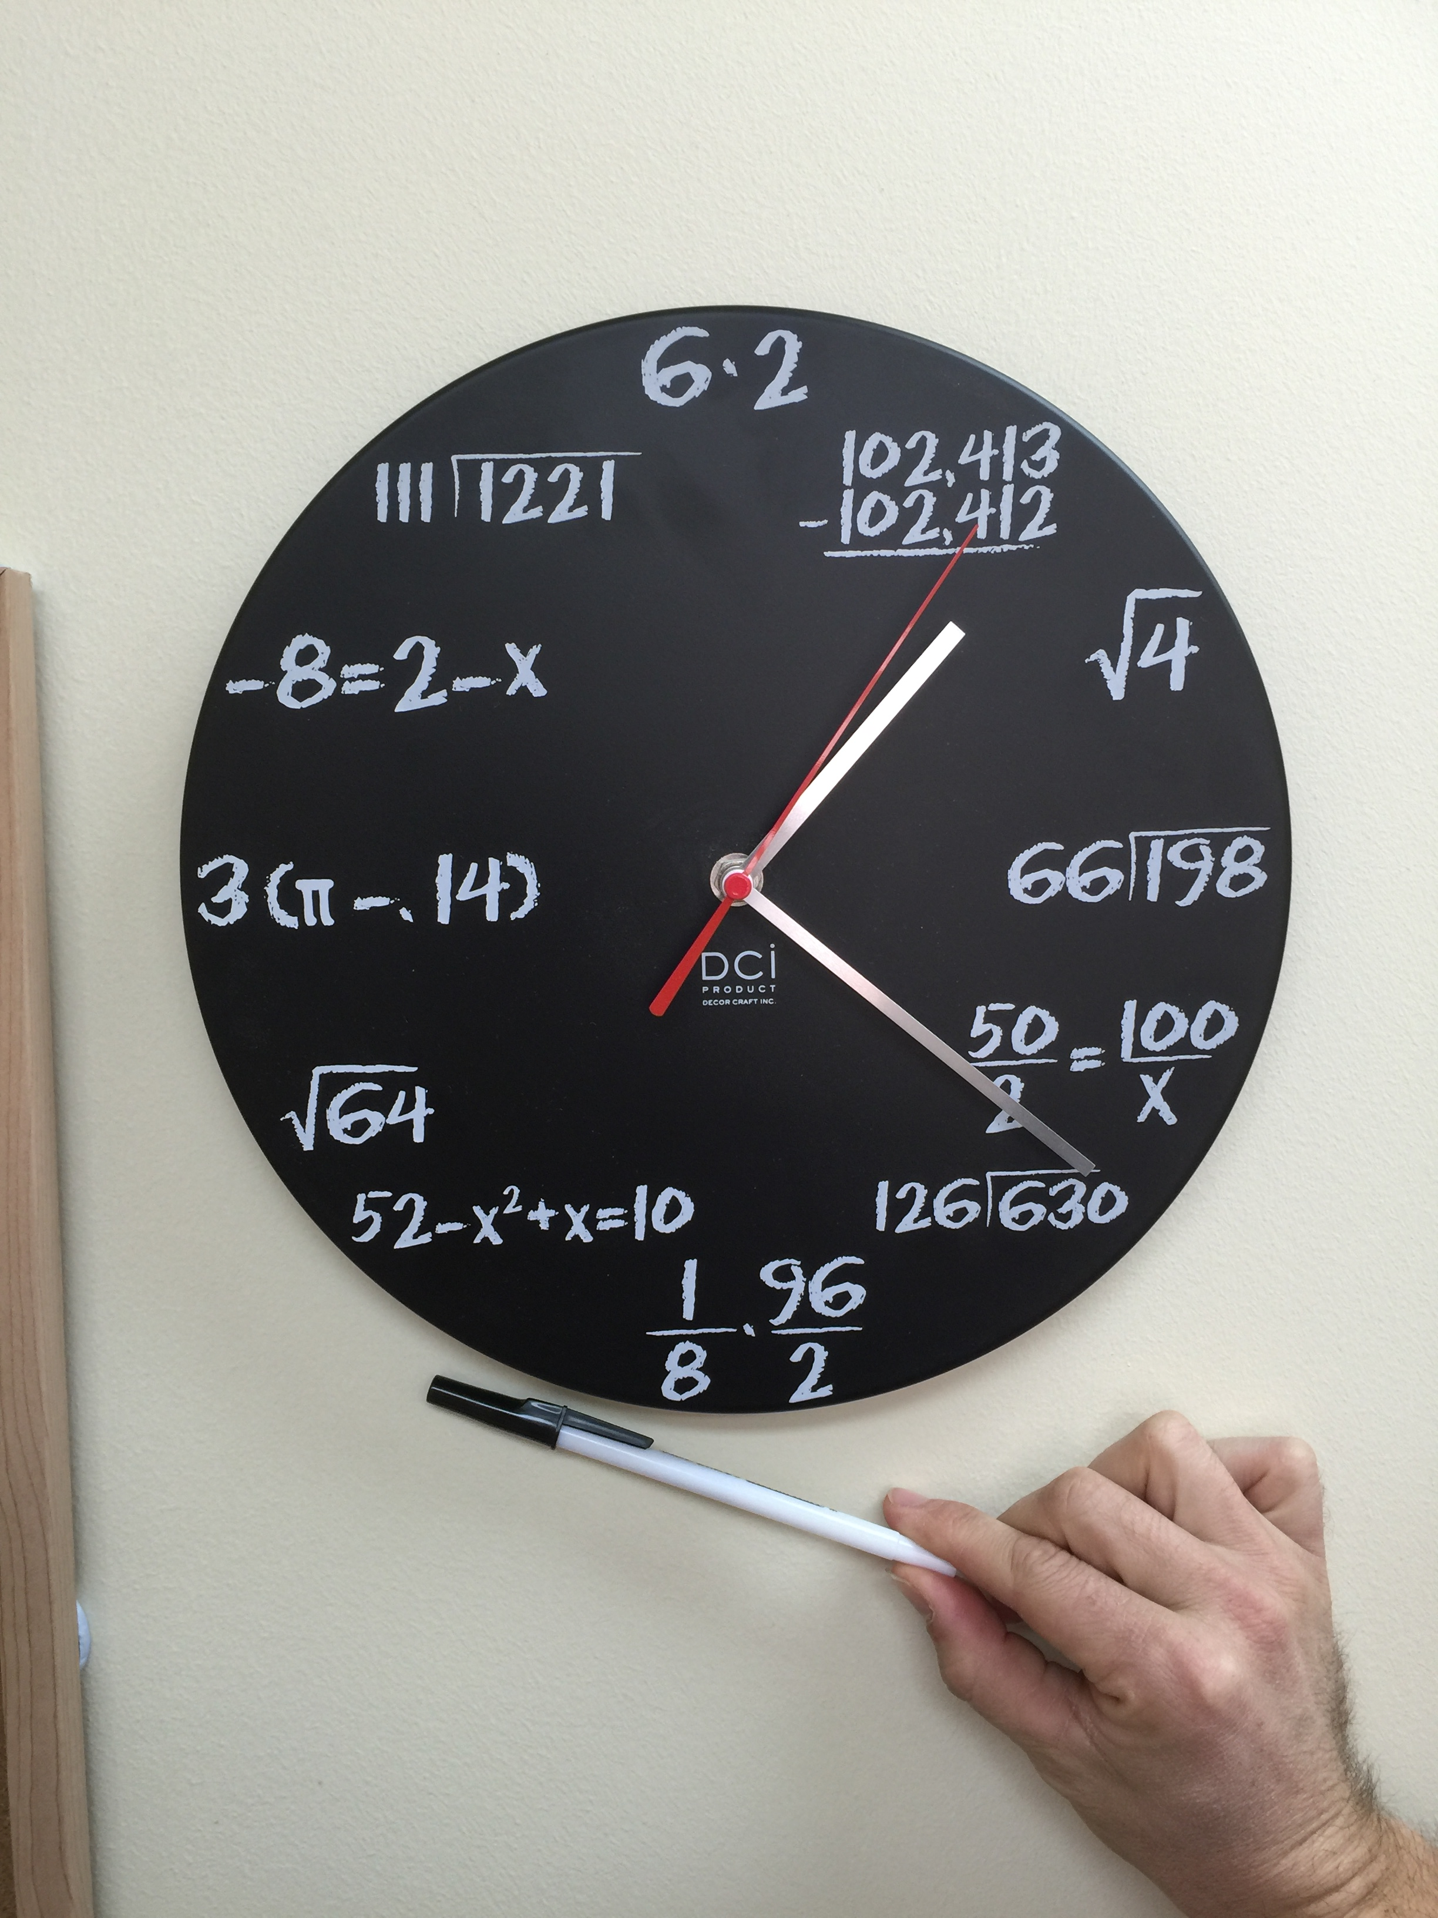
Does the…
tip of the minute hand
of a “standard” wall clock
travel more than, or less than
1metre in one hour?
<

Slide 16
Is the…
diameter of a trundle wheel
more than, or less than,
30 cm?

Slide 17
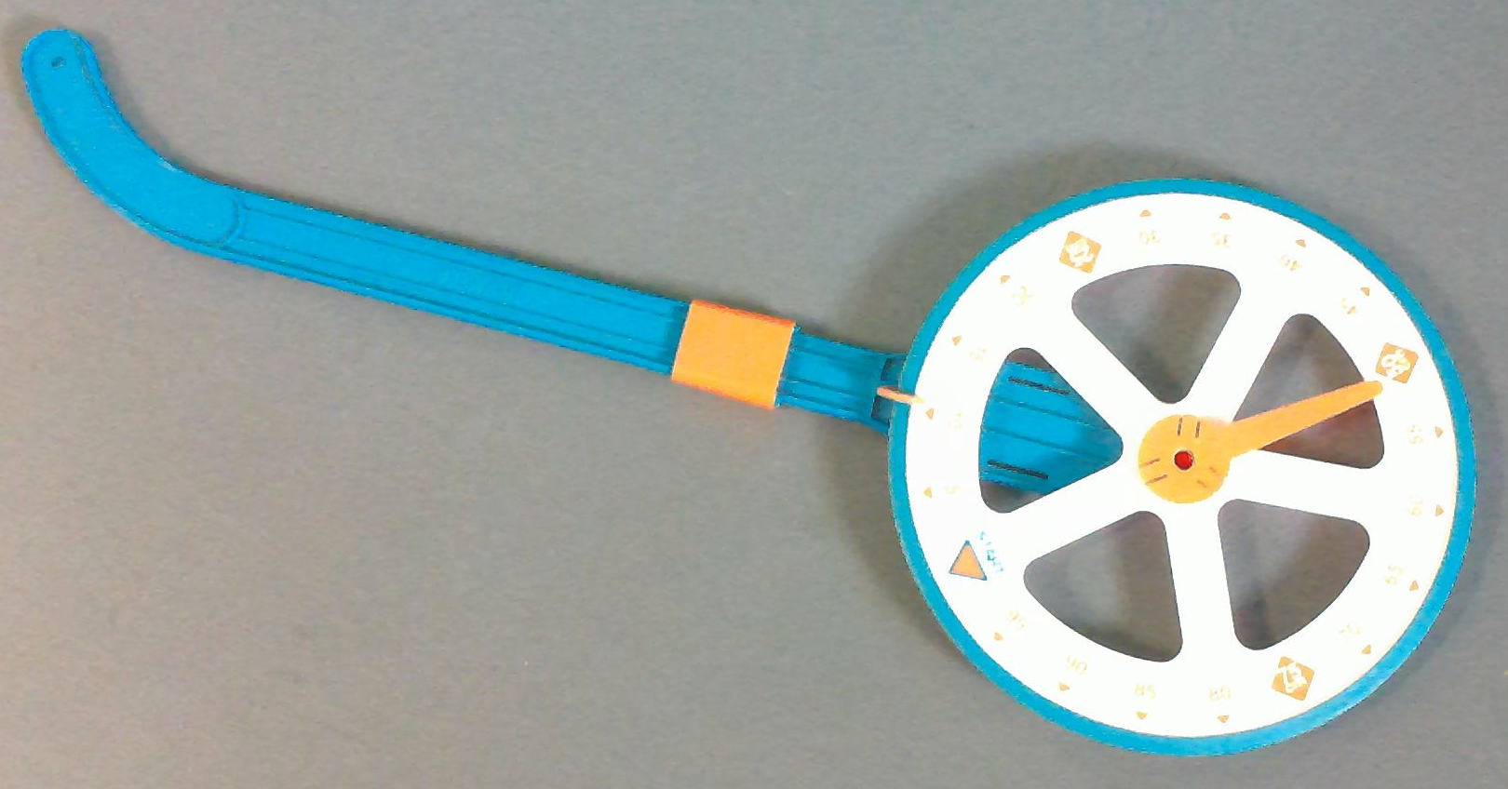
Is the…
diameter of a trundle wheel
more than, or less than,
30 cm?

Slide 18
Is the…
diameter of a trundle wheel
more than, or less than,
30 cm?
If it is a standard1m circumference
trundle wheel…
>

